Slide 1
Programming Fundamentals
Lecture 4

Slide 2
Objectives
To know about manipulators
setw() and setfill() manipulator
To know about Data type conversions
To know about casts
Cascading of << and >> operators

Slide 3
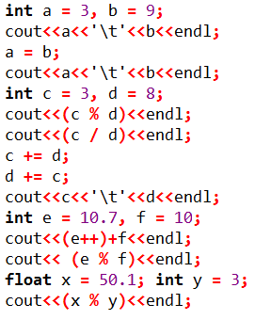
Review Problem 1
What will be the output of following piece of code?
Done in Class, Have a look at your lecture notes

Slide 4
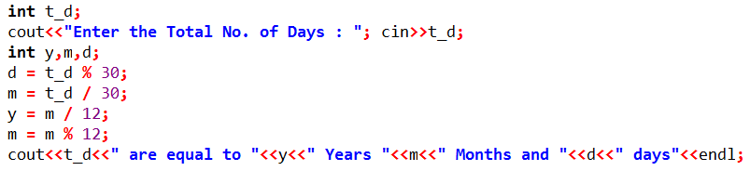
Review Problem 2
Write a code in C++ which will ask the user to enter his/her age in days and then show the age in Years, Months and Days.
For simplicity you may suppose that there are 30 days in each month

Slide 5
Manipulators
Manipulators are instructions to the output stream that modify the output in various ways
The commonly used manipulators are endl, setw() and setfill()
endl
endl manipulator terminates the line
setw()
setw() manipulator changes the field width of output
setfill()
setfill() manipulator fills the empty spaces of output with a specific character

Slide 6
setw() Manipulator
setw() manipulator accept an integer argument and display the text in that specified length
We can change the alignment of the text to left or right
The default alignment is right
We need to add the header file named iomanip to use setw() manipulator
Have a look at the example for more details of setw() manipulator

Slide 7
setfill() Manipulator
setfill() manipulator accept a character as an argument and fills the blank spaces with that particular character
For example the following line
cout<<setfill(‘.’)<<left<<setw(10)<<“Name”<<endl;
Will print the following
Name……

Slide 8
Practice Problem
Print the following message on screen
Name Age Savings
Ali 18 500
Usman 15 500
Sharjeel 22 1500
Modify your code to fill the empty spaces with dashes (-)
Solution is on next slide

Slide 9
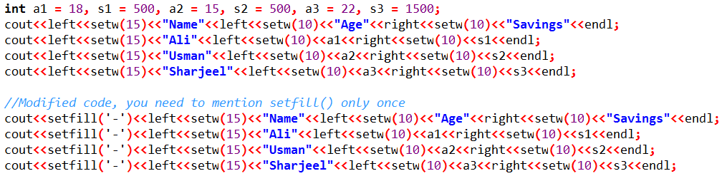
Practice Problem (Solution)

Slide 10
Type Conversions
Unlike many other programming languages C++ allows the expressions containing mixed data types
When we add several data types in a single expression, the C++ compiler converts the data types to a common one, and this process is called type conversion
The type conversions may happen in two different ways
Automatic conversions
Conversions through casts

Slide 11
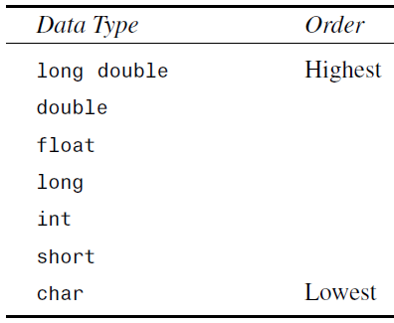
Automatic Data Type Conversions
When we mix two or more different data types in an expression the data type with the lowest order is converted into the data type of highest order (this is called implicit conversion)
Automatic conversions only work for built-in data types

Slide 12
Casts in C++
Implicit conversions are automatically performed when a value is copied to a compatible type
If we want to copy the value to a non-compatible type then we convert its type by using casts
There are several casts in C++ like
Static cast
Dynamic cast
Reinterpret cast
Constant cast
For the time being we will focus only on static cast

Slide 13
Static Cast
In C++ type conversion, the static_cast operator performs an explicit type conversion
All types of conversions that are well-defined and allowed by the compiler are performed using static_cast
The static_cast operator can be used for operations such as:
Converting a pointer of a base class to a pointer of a nonvirtual derived class
Converting numeric data types such as int to float or float to double

Slide 14
Syntax of Static_Cast
The syntax of using static_cast is
static_cast<new_type>(expression)
For example the following expression will convert the int x to a character, and assign the converted value to a character
int x = 65; char a;
a = static_cast<char>(x);
The traditional type-casting equivalents to above expressions would be:
(new_type) expression; // a = (char)x;
new_type(expression); // a = char(x);

Slide 15
Benefits of Static_Cast
There are several advantages of using static_cast and its syntax
We can convert between non-built-in data types
The implicit conversions are hard to see and hard to search, so it is too difficult to find the possible errors due to type conversions
By using new syntax we make sure that we are deliberately changing the data type and it is not a logical error

Slide 16
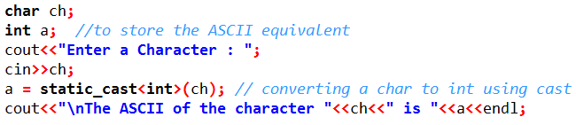
Practice Problem
Write a code which should ask the user to enter a character and display its equivalent ASCII code

Slide 17
Cascading in cout and cin
We have already seen that we can cascade the stream operator << in any C++ program, like
int a = 10, b = 20, c = 30;
cout<<a<<‘\t’<<b<<‘\t’<<c<<endl;
Similarly we can cascade the >> operator as well
The cascaded >> operator works for mixed data types, or we introduce dummy characters to such mixing
The benefit of cascading >> operator is, there will be no need to press the Enter key after typing every input
Have a look at the example for more clear understanding

